Slide 1
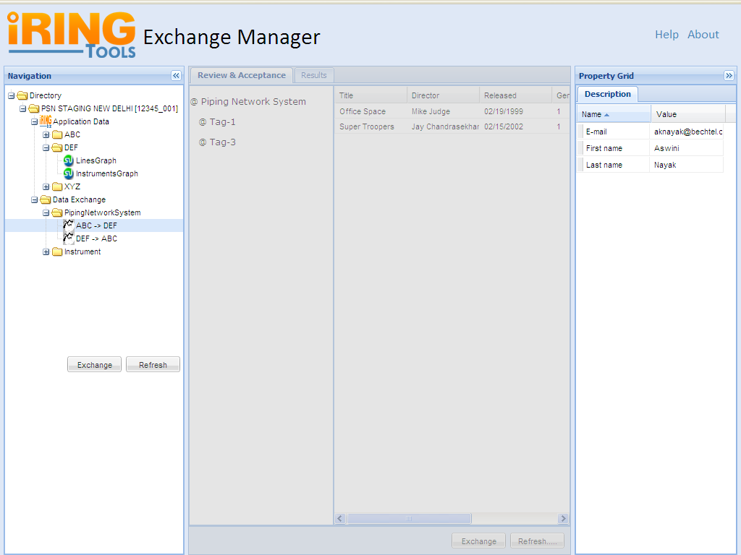

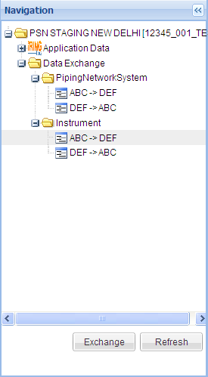
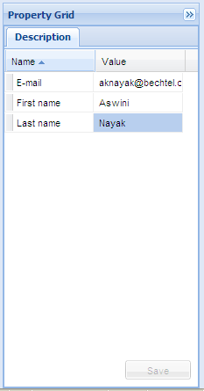
Exchange Manager
Help
About
Review & Acceptance
Results
Notes:
NAVIGATION PANEL: Mandays: [Slide 1 – 8]
=====================================================
Left Tree Panel
Property display for each Application/Graph/Exchange on Property Grid
Pagination [ Required? ]
Testing

Slide 2
As a User I want to View a List of Data Exchanges for each Project
Directory
Pump Search
@ Directory
@ Project A
@ App A
@ Commodity A
@ App A -> App B
@ Commodity B
@ App A -> App B
@ App B
@ Commodity A
@ App B -> App A
@ Commodity B
@ App B -> App A
@ Project B
@ Project C
<< 1 2 3 4 5 >>

Slide 3
As a User I want to Refresh the list of Data Exchanges on a Project.
Directory
@ Directory
@ Project A
@ App A
@ Commodity A
@ App A -> App B
@ Commodity B
@ App A -> App B
@ App B
@ Commodity A
@ App B -> App A
@ Commodity B
@ App B -> App A
@ Project B
@ Project C
Refresh

Slide 4
As a User I want to select a Project and View its Properties.
Directory
@ Directory
@ Project A
@ App A
@ Commodity A
@ App A -> App B
@ Commodity B
@ App A -> App B
@ App B
@ Commodity A
@ App B -> App A
@ Commodity B
@ App B -> App A
@ Project B
@ Project C
Property A
Property B
Property C
Value 1
Value 2
Value 3

Slide 5
As a User I want to select an Application and View its Properties.
Navigation
@ Directory
@ Project A
@ App A
@ Commodity A
@ App A -> App B
@ Commodity B
@ App A -> App B
@ App B
@ Commodity A
@ App B -> App A
@ Commodity B
@ App B -> App A
@ Project B
@ Project C
Property A
Property B
Property C
Value 1
Value 2
Value 3

Slide 6
As a User I want to select an Commodity and View its Properties.
Directory
@ Directory
@ Project A
@ App A
@ Commodity A
@ App A -> App B
@ Commodity B
@ App A -> App B
@ App B
@ Commodity A
@ App B -> App A
@ Commodity B
@ App B -> App A
@ Project B
@ Project C
Property A
Property B
Property C
Value 1
Value 2
Value 3

Slide 7
As a User I want to select a Data Exchange and View its Properties.
Directory
@ Directory
@ Project A
@ App A
@ Commodity A
@ App A -> App B
@ Commodity B
@ App A -> App B
@ App B
@ Commodity A
@ App B -> App A
@ Commodity B
@ App B -> App A
@ Project B
@ Project C
Property A
Property B
Property C
Value 1
Value 2
Value 3

Slide 8
As a User I want to select a Data Exchange and Start it.
Directory
@ Directory
@ Project A
@ App A
@ Commodity A
@ App A -> App B
@ Commodity B
@ App A -> App B
@ App B
@ Commodity A
@ App B -> App A
@ Commodity B
@ App B -> App A
@ Project B
@ Project C
Property A
Property B
Property C
Value 1
Value 2
Value 3
Refresh
Exchange

Slide 9
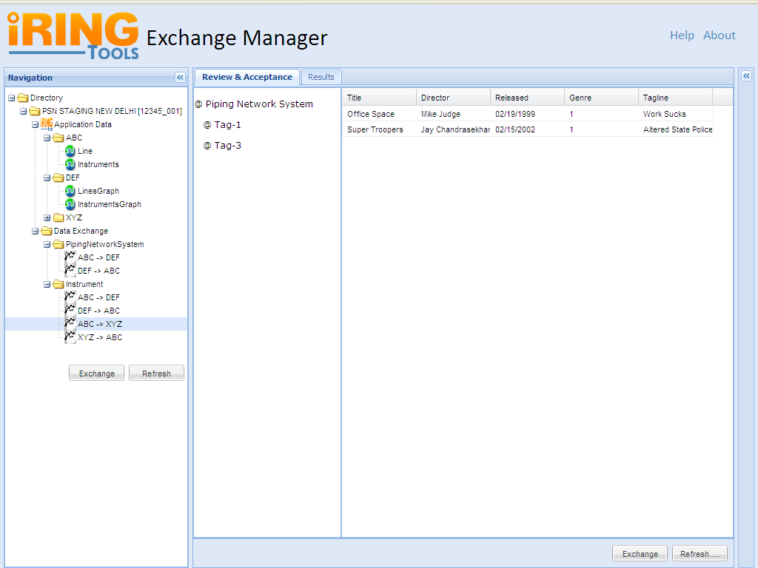
As a User I want to be Warned before Starting a Data Exchange without reviewing it.
Directory
@ Directory
@ Project A
@ App A
@ Commodity A
@ App A -> App B
@ Commodity B
@ App A -> App B
@ App B
@ Commodity A
@ App B -> App A
@ Commodity B
@ App B -> App A
@ Project B
@ Project C
Property A
Property B
Property C
Value 1
Value 2
Value 3
Would you like to review the Data Exchange before starting?
Yes
No
Refresh
Exchange

Slide 10
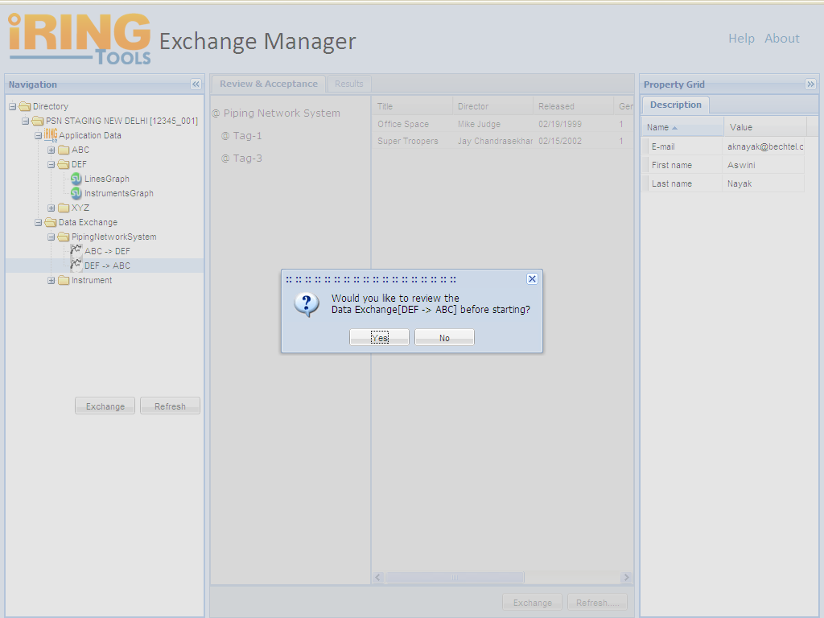

Slide 11
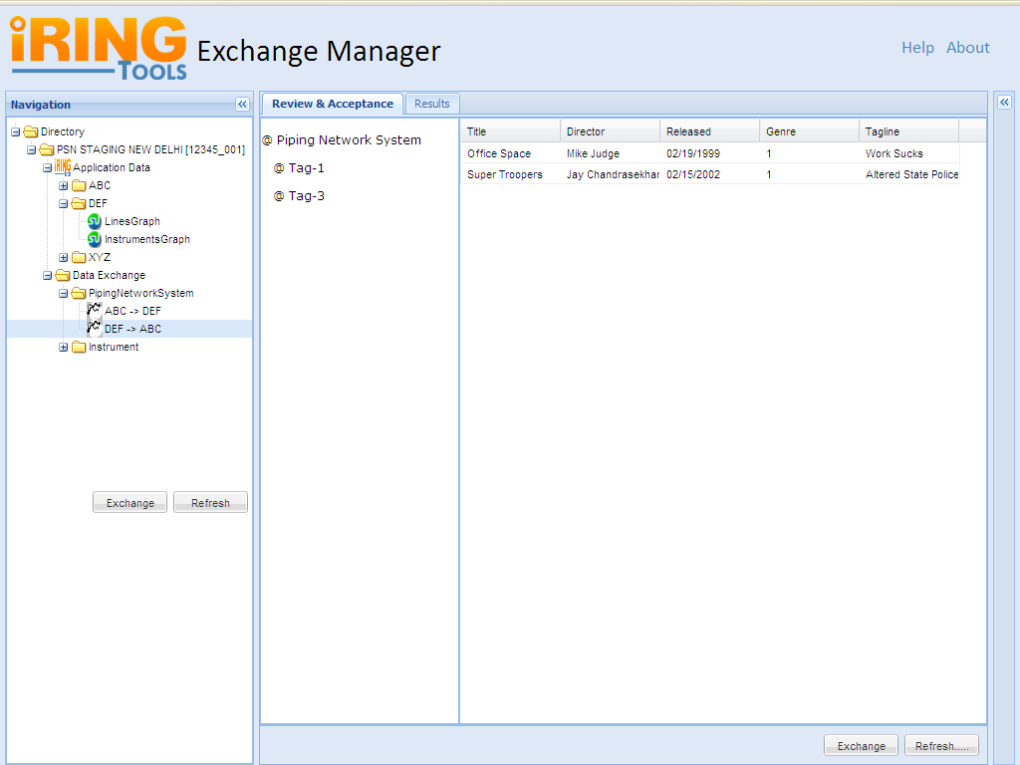
Pagination
Notes:
Review & Acceptance Mandays:??
==================================
1. DXI Handling with Pagination
2. DXO Handling
3. Data Transfer

Slide 12
As a User when a Data Exchange is completed I want to be prompted to review the Results.
Directory
@ Directory
@ Project A
@ App A
@ Commodity A
@ App A -> App B
@ Commodity B
@ App A -> App B
@ App B
@ Commodity A
@ App B -> App A
@ Commodity B
@ App B -> App A
@ Project B
@ Project C
Property A
Property B
Property C
Value 1
Value 2
Value 3
Data Exchange “App B -> App A” has completed. Would you like to review the Results?
Yes
No
Refresh
Exchange

Slide 14
As a User I want to select a Data Exchange and View its Results.
Directory
Results
@ World
@ Project A
@ App A -> App B
@ App A -> App C
@ App B -> App A
@ App B -> App C
@ App C -> App A
@ App C -> App B
@ Project B
@ Project C
Property A
Property B
Property C
Value 1
Value 2
Value 3

Slide 15
As a User I want to select a Data Exchange and View its Results.
Results
@ ProjectA_CommodityB_AppB_X_AppA
@ ProjectA_CommodityB_AppB_X_AppA
@ ProjectA_CommodityB_AppB_X_AppA
@ ProjectA_CommodityB_AppB_X_AppA

Slide 16
As a User I want to select a Data Exchange and View its Results.
Results
@ ProjectA_CommodityB_AppB_X_AppA
@ ProjectA_CommodityB_AppB_X_AppA
@ ProjectA_CommodityB_AppB_X_AppA
@ ProjectA_CommodityB_AppB_X_AppA
Message Text 1 …
Message Text 2 …
Message Text 3 …
Message Text 4 …

Slide 17
As a User I want to select a Data Exchange and View its Results.
Directory
Review & Acceptance
@ World
@ Project A
@ App A -> App B
@ App A -> App C
@ App B -> App A
@ App B -> App C
@ App C -> App A
@ App C -> App B
@ Project B
@ Project C
Property A
Property B
Property C
Value 1
Value 2
Value 3

Slide 18
Review & Acceptance
@ Piping Network System
@ □ Tag-1
$$ P And I Diagram
@ M-6-AB-001
@ M-6-AB-002
@ M-6-AB-003
@ □ Tag-2
@ ABC002
@ □ Tag-3

Slide 19
As a User I want to select a Data Exchange and View its Results.
Review & Acceptance
@ Lines
@ □ Piping Network System (“Tag-1”)
@ IdentificationByTag.valIdentifier (“Tag-1”)
@ Plant Area (“1”)
@ IdentificationByTag.valIdentifier (“1”)
@ System
@ IdentificationByTag.valIdentifier (“AB”)
@ P And I Diagram (“M-6-AB-001”)
@ DrawingIdentification.valIdentifier (“M-6-AB-001”)
@ DrawingRevision.valIdentifier (“0 “-> “A”)
@ P And I Diagram (“M-6-AB-002”)
@ DrawingIdentification.valIdentifier (“M-6-AB-002”)
@ DrawingRevision.valIdentifier (“0”)
@ P And I Diagram (“M-6-AB-003”)
@ □ Piping Network System (“Tag-2”)
@ □ Piping Network System (“Tag-3”)
UNUSED DRAFT

